Slide 1
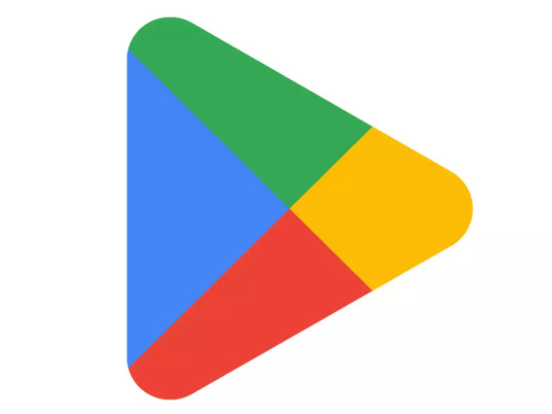
Capstone Project Play Store App Review Analysis
Team Members-
Aanchal Kankrecha
Sonika Baheti

Slide 2
CONTENT
Points of interest
Objective
Data Overview
Data Cleaning
Exploratory Data Analysis
Conclusion

Slide 3
Point of Interest
Correlation matrix
Reviews vs installation
Category wise installation
Category wise apps
Uninstalled apps
Top 3 gaming, communication and tooling Apps?
Content rating wise apps
Content rating wise installation
Revenue generated by paid apps
Percentage of free vs paid apps
Free and paid apps per category
Apps with their type having rating 5
Distribution of Rating

Slide 4
Point of Interest
Distribution of size of apps
Average rating of each category
No. of apps in each genres
Rating vs Price
Rating vs Installs
Last updated Apps
No. of translated reviews of different apps
Maximum translated reviews Apps
Distribution plot of sentiment polarity
Distribution plot of sentiment subjectivity
Percentage of sentiment count
Conclusion

Slide 5
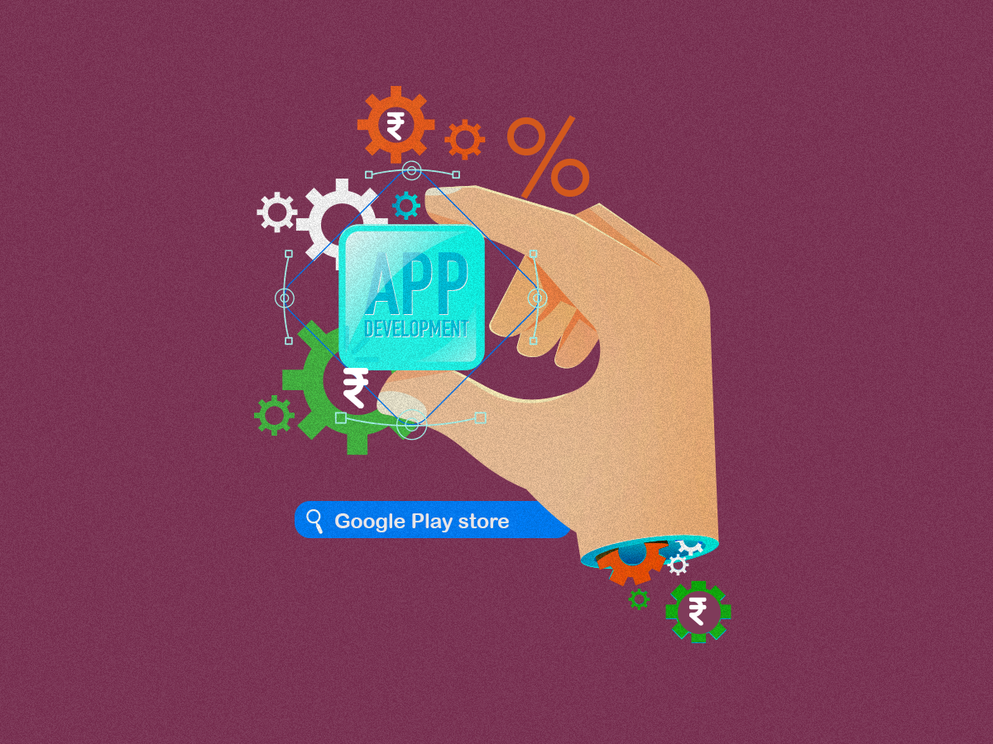
Objective
Our goal is to explore the insights of Play store dataset and extract the useful information to meet the choice and demand of the users and their preferences of app installation on the basis of Reviews and Ratings.

Slide 6
Data Overview
Dataset 1:
Play store review analysis table is loaded in colab as df, this table contain following columns:
App | Category | Rating | Reviews | Size | Installs | Type | Price | Content Rating | Genres | Last updated | Current version | Android version
Dataset 2:
User Review dataset is loaded in colab as df2, this table contains the following columns:
App | Translated Review | Sentiment | Sentiment Polarity | Sentiment Subjectivity

Slide 7
Play store app review analysis Data Summary
In given play store dataset, we have following features:
1. App – Name of the app 2. Category – Category of the app 3. Rating - Over all user rating of the app out of 5 on the Play Store 4. Size – Size of app 5. Reviews – Number of user reviews for the app 6. Installs – Number of user downloads/installs for the app 7. Type – Paid or free 8. Price – Cost of the app 9. Content Rating – Age group the app is targeted at 10. Genres - An app can belong to multiple genres 11. Last Updated - Date when the app was last updated on Play Store 12. Current Version - Current version of the app available on Play Store 13. Android Version – Minimum required android version

Slide 8
User Review Data Summary
App – An app name
Translated Review – Review given by users in words.
Sentiment – Sentiment given to an app by users ( i.e., Positive, Neutral, Negative).
Sentiment Polarity – The polarity of sentiment measures how negative or positive the context is. In the data we have, the polarity ranges from +1(Positive) to -1(Negative).
Sentiment Subjectivity - The subjectivity of a sentiment is how likely that sentiment is to be based on personal opinions or public notions.

Slide 9

Overview and understanding of dataset
-> info(): It informs about data columns and data types. -> head(): It returns the first five data. -> tail(): It returns the last five data. -> columns : It returns data columns -> shape : It gives number of rows and columns in a tuple.

Slide 10
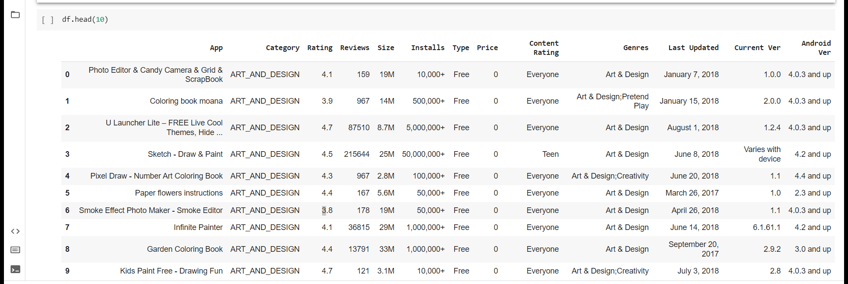
Head of the Play store dataset

Slide 11
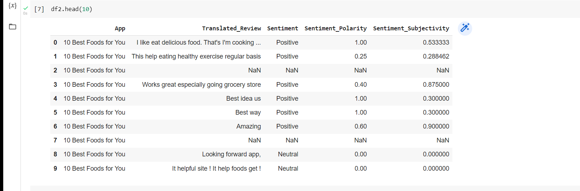
Head of User Review Dataset

Slide 12
Data Cleaning
Price, Installs Removed special characters(‘+’,’$’,’,’)
Filled null values by 0.
Size Removed special characters
Converted in Kbs.
Rating Replaced null values with 0.
Reviews Changed data type to float
Type Filled nan values with Free
Last updated Replaced varies with device values with
Android version their respective modes.
Current version

Slide 13

Exploratory Data Analysis
Let the DATA tell the story ☺

Slide 14
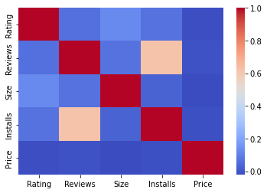
Heatmap
This shows that there exist positive correlation between Installs and Reviews and very less correlation among other Variables. Maximum no. of reviews are 8871 from the range 0 to 20,00,000 having maximum no. of installs as 7666. Thus validating the conclusion of heatmap that there exist positive correlation between Reviews and Installs

Slide 15
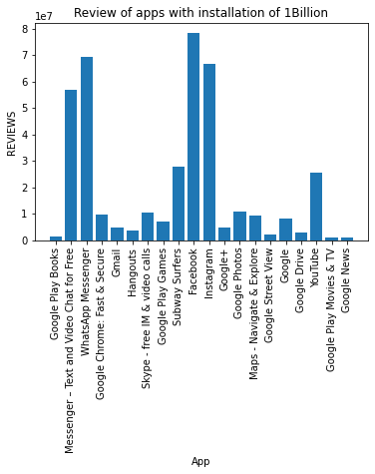
To check no. of reviews of apps having 1 Billion installs
This graph suggests that Facebook has the maximum no. of reviews when installs is 1B.

Slide 16
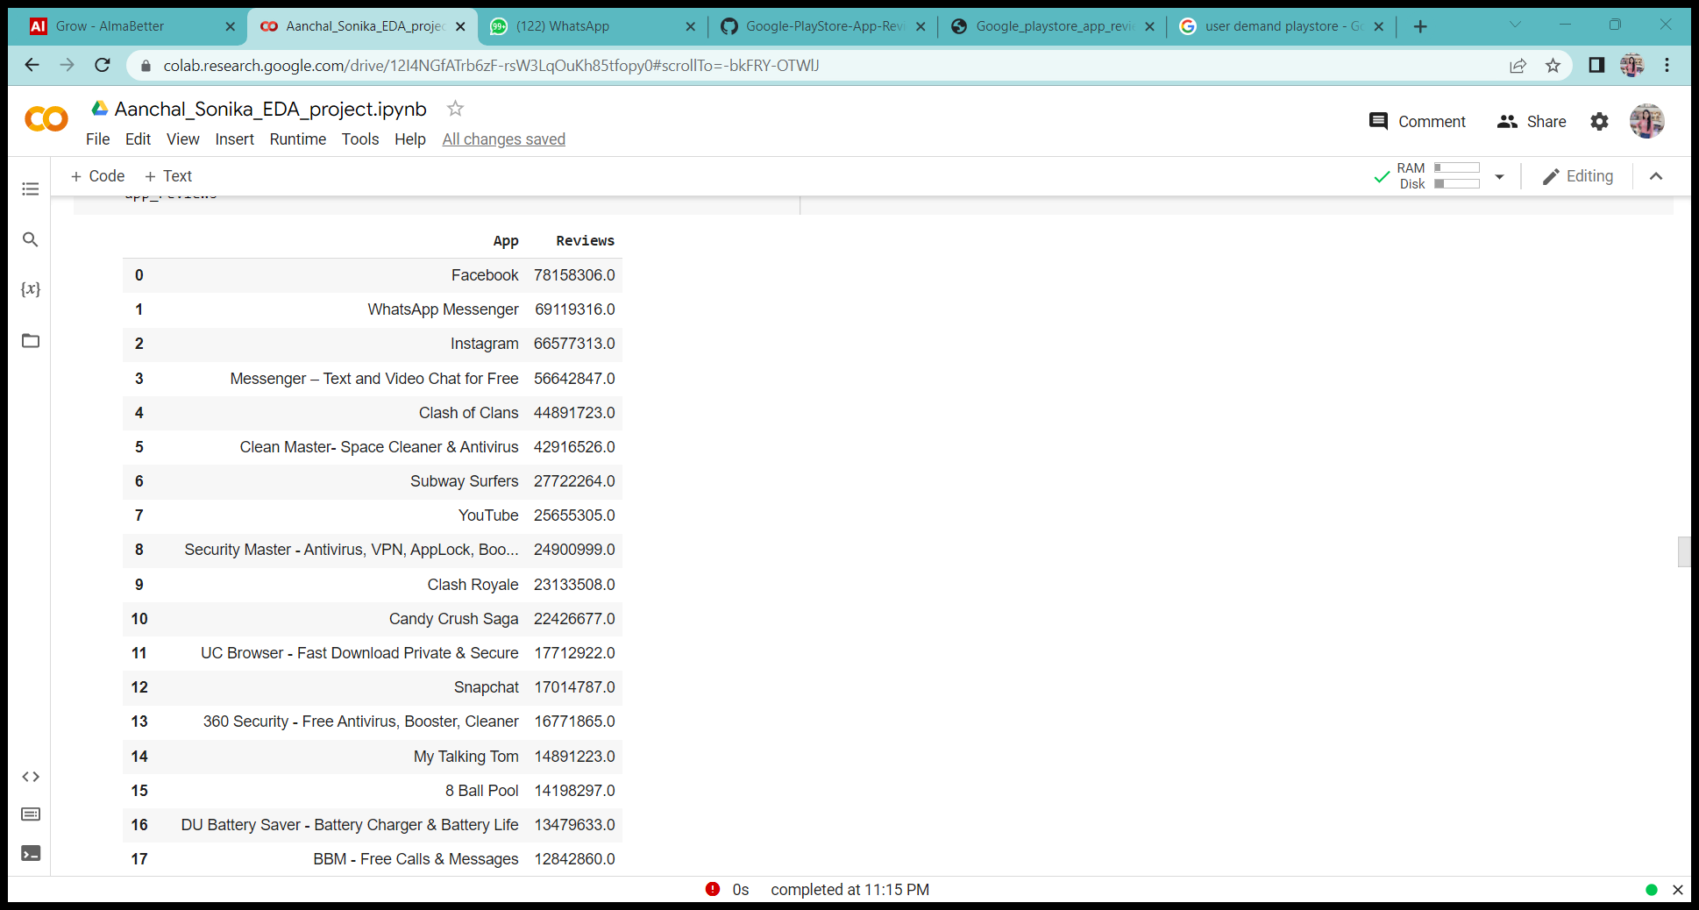
Facebook has the highest number of reviews among all the apps ,i.e., 78,158,306.0

Slide 17
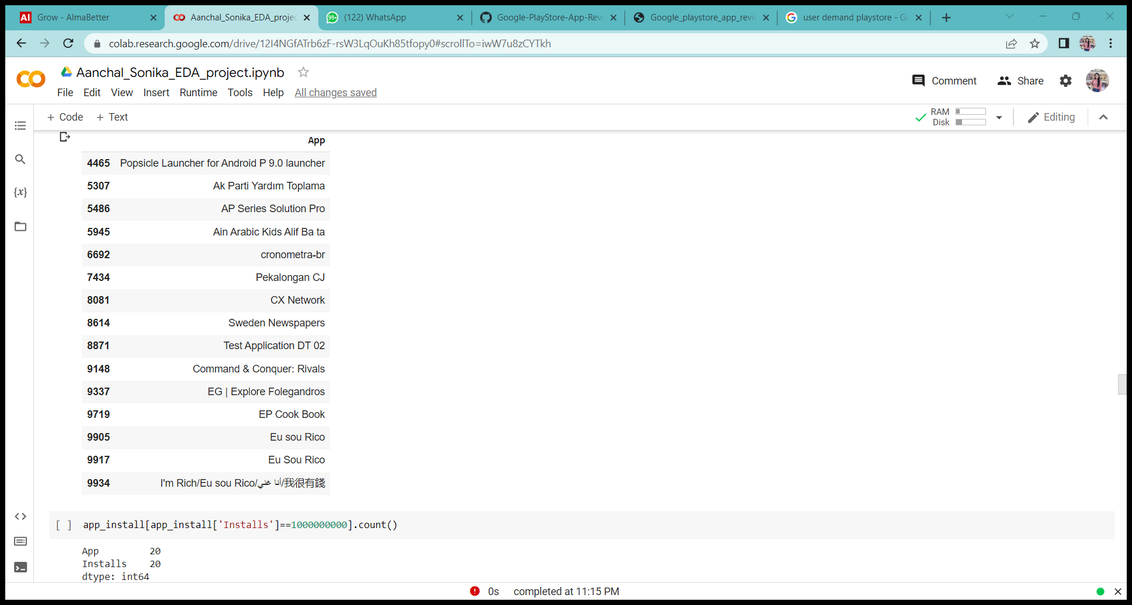
List of apps having Zero installs
There are total 15 uninstalled apps.

Slide 18
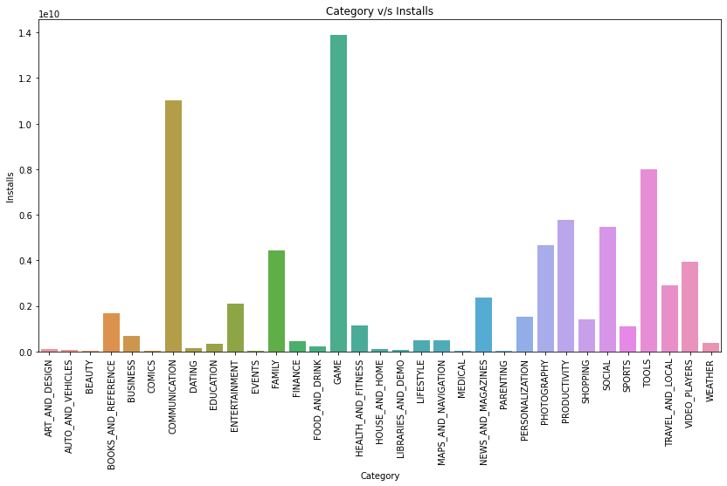
Which category has the highest Installs
Games are the most downloaded category followed by communication and tools.

Slide 19
Top 3 Apps of categories having maximum installs.
 | game | communication | tool
 | Subway Surfers | Messenger – Text and Video Chat for Free | Google
 | Candy Crush Saga | Skype - free IM & video calls | Google Translate
 | Temple Run 2 | WhatsApp Messenger | Clean Master- Space Cleaner & Antivirus

Slide 20
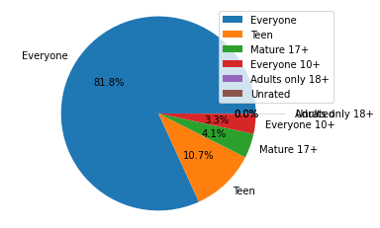
Number of apps belonging to each Content Rating
 | Content Rating | No of Apps
0 | Everyone | 7903
1 | Teen | 1036
2 | Mature 17+ | 393
3 | Everyone 10+ | 322
4 | Adults only 18+ | 3
5 | Unrated | 2

Slide 21
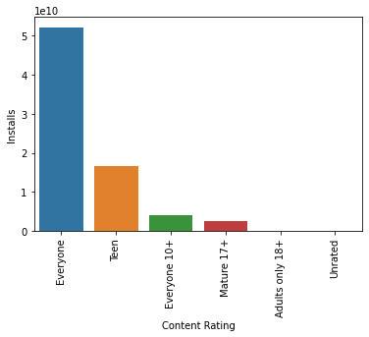
How much Installs are made for each type of content Rating ?
Content Rating | Installs
Everyone | 52179352961
Teen | 16487275393
Everyone 10+ | 4016271795
Mature 17+ | 2437986878
Adults only 18+ | 2000000
Unrated | 50500

Slide 22
See the revenue of Top paid apps
App | Revenue
Minecraft | 69900000.000000
I am rich | 39999000.000000
I Am Rich Premium | 19999500.000000
Hitman Sniper | 9900000.000000
Grand Theft Auto: San Andreas | 6990000.000000
Minecraft generates the maximum revenue.

Slide 23
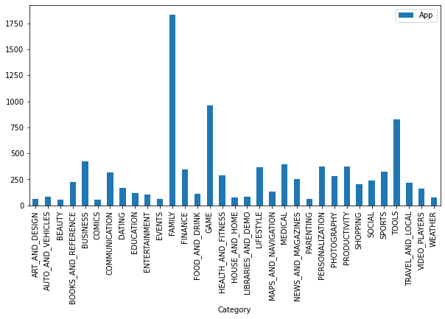
Category wise app distribution
From graph it can be clearly seen that play store has most apps for family followed by games and tools

Slide 24
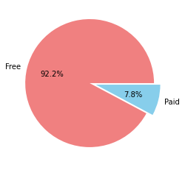
Free v/s Paid Apps
Type | App
Free | 8903
Paid | 756
More free apps are available on play store.
Approximately 92% of the apps on play store are free while 8% are paid apps.

Slide 25
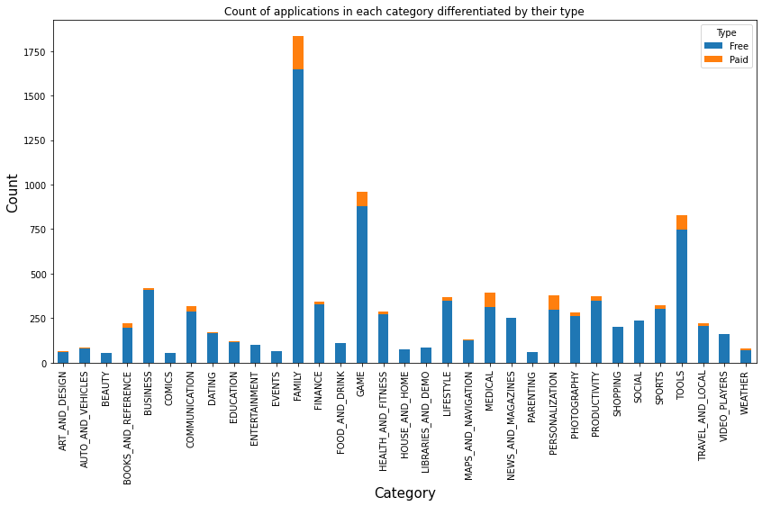
No. of free and paid apps for each category.

Slide 26
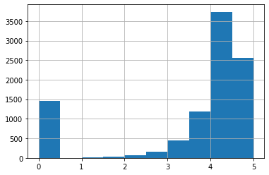
Histogram of rating
Most of the apps has rating between 3 and 5.
Average rating of app is 4.2 on play store.

Slide 27
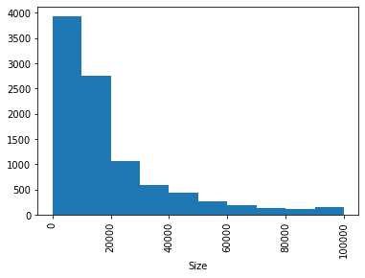
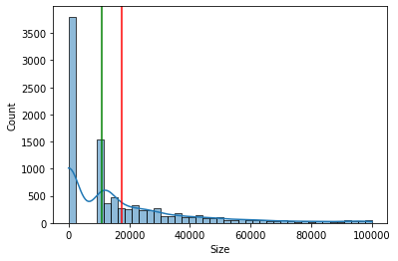
Distribution of Size
.
From the above plot we can infer that data of size is right tailed because mean>median
Most of the apps are of size between 1kb to 20 mb
Mean Size of app is : 17435.69264934258 kb Median Size of app is : 11000.0 kb

Slide 28
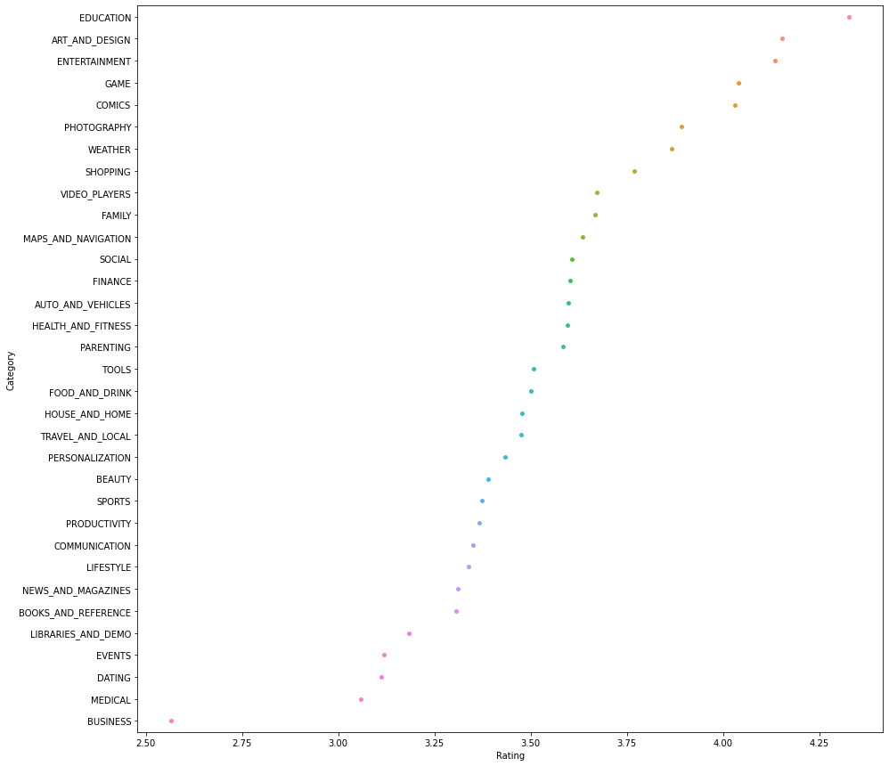
Average rating of each category
Education has the maximum average ratings of 4.3 followed by ART_AND_DESIGN 4.153125 & ENTERTAINMENT 4.135294

Slide 29
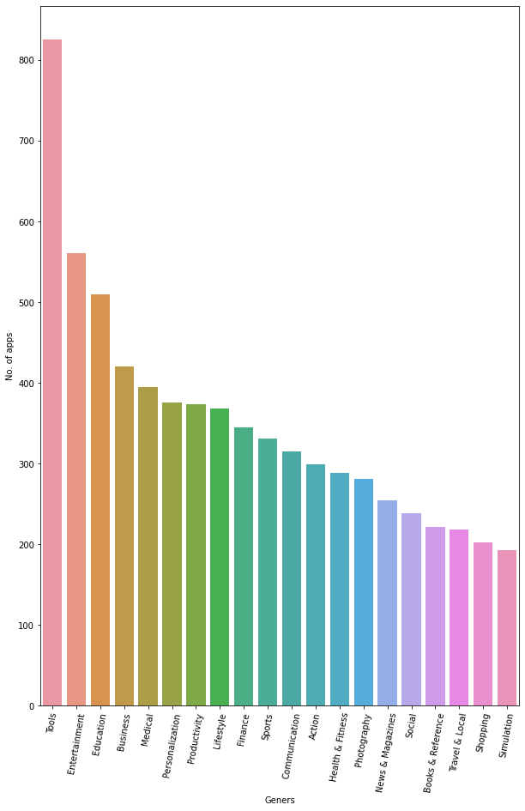
Genres with Number of Apps
Tools are the Most trending Genres among all genres , followed by Entertainment and Education.

Slide 30
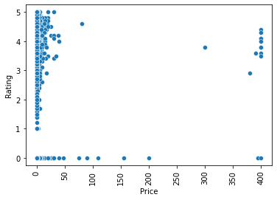
How Rating Changes with Price
Different Ratings are given to free apps while high paid apps are given much good ratings.

Slide 31
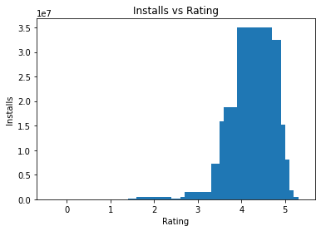
How Rating and Installs are related?
Higher rated apps have more installs.

Slide 32
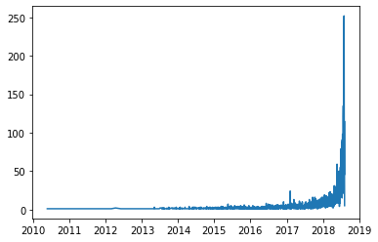
Have a view on Last Updated of Apps
Last updated date | Max No. of apps updated
2018-08-03 | 252
Mostly Apps are updated in the year 2017,2018,2019.

Slide 33
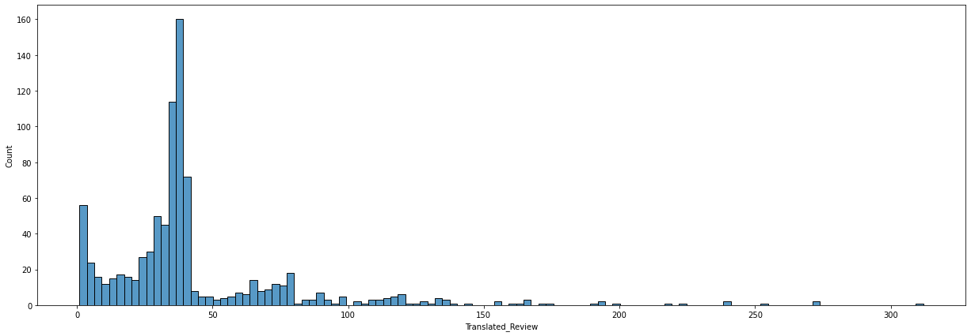
Distribution plot of translated reviews
App name | Translated_Review
Bowmasters | 312

Slide 34
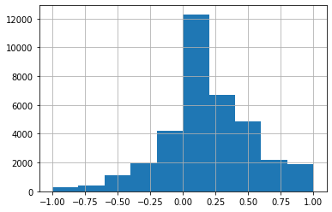
Distribution of sentiment polarity
Sentiment polarity is almost normally distributed.

Slide 35
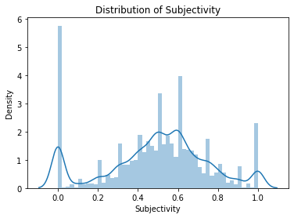
Distribution of sentiment subjectivity
From the above plot sentiment subjectivity mostly lies between 0.4 to 0.8

Slide 36
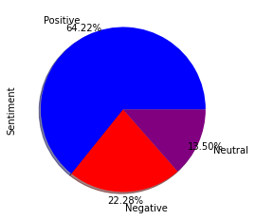
See the percent of Sentiment Counts
Here we can see that there are almost 64% positive Reviews given to apps ,i.e., most of the apps have positive effect on users.
Positive | 23073
Negative | 8005
Neutral | 4851

Slide 37
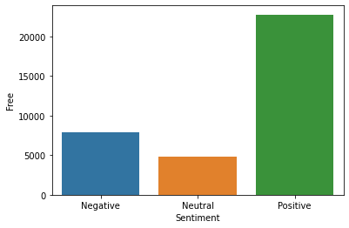
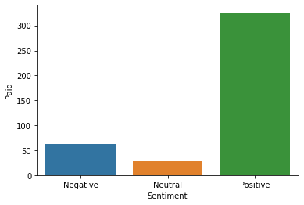
Sentimental analysis for free and paid apps
Free and paid apps mostly have positive sentiments.
Paid apps have low negative and neutral sentiments compare to free.

Slide 38
YAY!! The story Unfolds here...

Slide 39
CONCLUSION:
Facebook has the maximum number of reviews.
There are total 15 apps which are uninstalled.
There are total 20 apps having 1 B installs.
Games are the most downloaded category followed by communication and tools.
Most of the apps are from content rating as everyone equivalent to 81.8%.
Content rating as Everyone has the maximum no. of installs.
Minecraft application generates the maximum revenue.
Most of the apps are for family followed by games and tools.
92% of the apps on play store are free while 8% are paid apps.

Slide 40
CONCLUSION:
Average rating of apps on play store is 4.2
Most of the apps are of size between 1Kb to 20Mb.
Education category has maximum average rating as 4.3
Tools are the most famous genres having 826 apps on play store.
Free apps has varying ratings while paid apps generally have high ratings.
Mostly apps are updated in the year 2017,2018,2019.
‘Bowmaster’ app has the maximum translated reviews as 312.
Sentiment subjectivity mostly lies between 0.4 to 0.8
There are almost 64% positive Reviews given to apps ,i.e., most of the apps have positive effect on users.

Slide 41
